Slide 1
Homework in Primary 1
Supporting your child’s learning

Slide 2
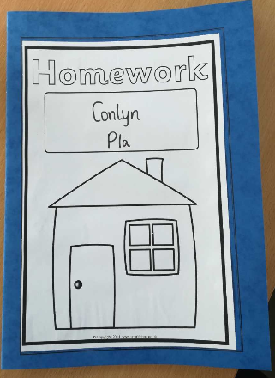
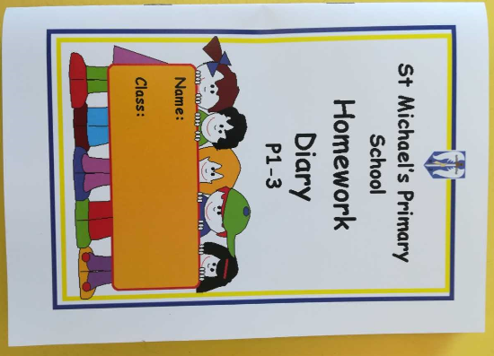
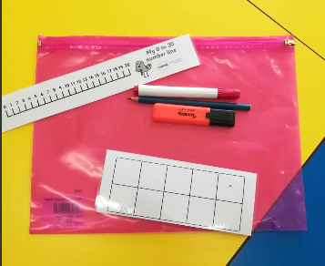
Homework Materials
Children will be issued with the following:
A homework diary
A homework jotter
Some simple materials to support learning in maths
and language, in a zip lock folder
Reading book and extended story/ info
A folder to keep everything in
What we need from you:
Two small tubs- one for sounds and one for words- to be used at home.

Slide 3
What and When?
Homework should be completed Monday night through to Thursday night. It will consist of a range of number/ maths, language and health and wellbeing tasks.
Occasionally there may be a focus week, class assembly or show to prepare for. On such weeks the usual homework routines may be a little different.
Show and Tell/ model making will be issued with extra time to prepare/ complete.
Some tasks will be explicitly requested, eg a shape worksheet or reading.
On some days there will be a choice of activities which are laid out on a grid.
Please do not skip on through work, eg letter formation booklets.
Homework should not take long if completed daily and should not be a stressful experience.
Homework will be detail checked on a Friday. Please try to catch up with any missed pieces.

Slide 4
Diary
Homework diaries will have a note of what to do each evening. This note goes in the diary on a Monday. **
Late-coming/ absence on a Monday can cause homework to be missed. Please check your child’s folder on the Tuesday before you leave.
Please sign daily to indicate completion.
Feel free to leave comments or non urgent questions in the diary and we will respond by the following Monday.
Handy features include a list of the common words and a space to record which books your child has read.

Slide 5
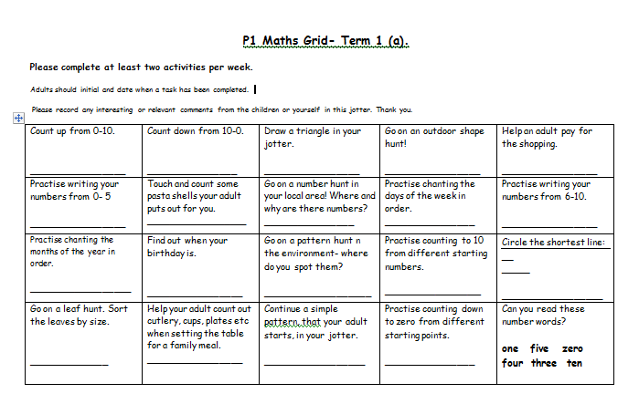
Jotter/ Grids
Homework jotters are where you will find the MNU, language and HWB ‘choice’ grids mentioned earlier.
They will also contain any worksheets that have to be completed as mentioned on the weekly homework note.
Jotters provide a space for our child to complete written tasks, drawings etc.

Slide 6
Reading Books
Usually change weekly
Start wordless and get more advanced
Come with an extended story which gives background, further info and discussion ideas- please read over this prior to reading with your child
Must be in folders daily as your child’s group may be asked to read/ complete tasks relating to the book any day
Must be returned to school on the Friday so they can be returned to storage for others to use
See the language grid for other reading ideas

Slide 7
Folders
Please check folders every night for any important letters
If you have a return slip or letter for us that we need to see before the Friday please tell your child to give this to us
Should come to school daily with reading book inside
Please clear out any letters, leaflets etc by the Friday, this makes our task of checking all the diaries and jotters a little easier- thank you!
Folders must come back on a Friday so we can check homework and start getting the following week’s into them
We do not need the resources folder, or its contents, back.

