Slide 1
Supporting Your Child’s Learning
21st August 2019

Slide 2
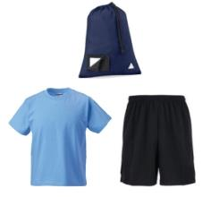
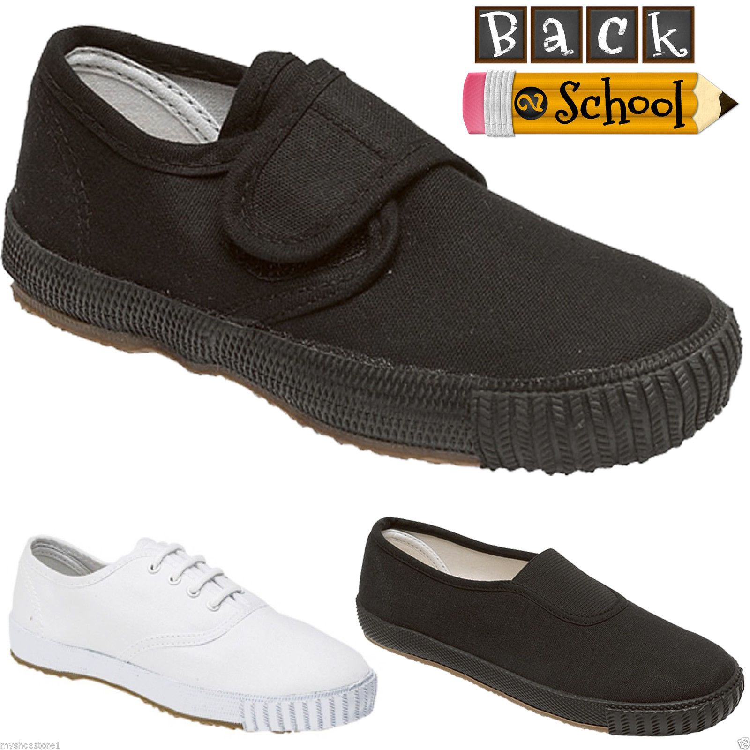
Gym Kits
Shorts, t-shirt and soft indoor shoes; label all kit
No jewellery/accessories
No football colours
Kept in school; sent home termly
Encourage independence

Slide 3
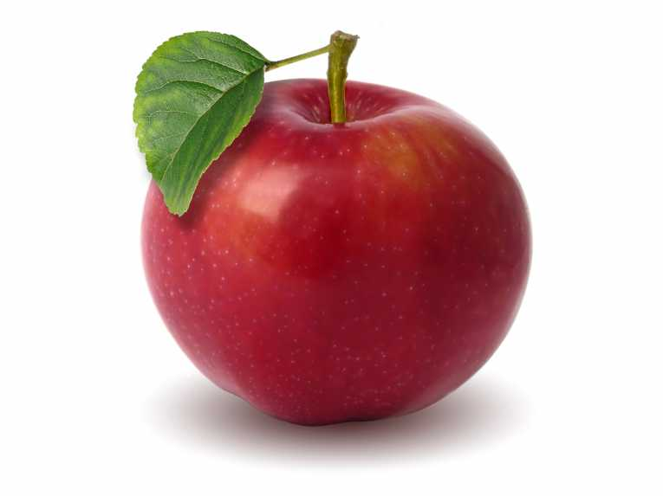
Lunch/Snacks
Encouraged to bring a healthy fruit snack for playtime
1 or 2 small snacks only
Water bottles; plain water only
Lunch & snack
No snacks containing nuts
Toileting – please let us know if your child has a medical condition and needs the toilet regularly.
This Photo by Unknown Author is licensed under CC BY-NC-ND

Slide 4
Home-time
Please call office to inform of pick-up changes
Please wait behind the white line*
Informal conversations; please wait until all children are dismissed
To enter the building you must walk round to the main entrance

Slide 5
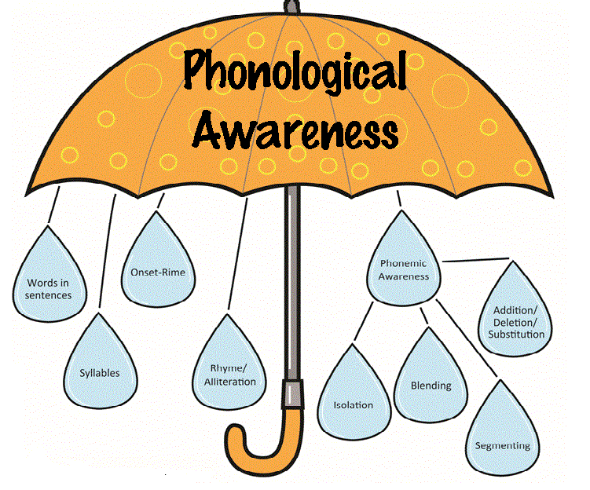

Slide 6
Literacy – Phonological Awareness
Ability to recognise and work with sounds.
Important beginner concepts;
- Rhyme (e.g. sun, bun, fun)
- Syllabification (e.g. com-put-er, flow-er)
- Alliteration (e.g. Peppa Pig, Mickey Mouse)
- Sound positioning (where do you hear a in cat)
- Words in sentences (e.g. count how many words make up the sentence. Can they identify single words?)
https://www.topmarks.co.uk/Search.aspx?q=online%20rhyming%20games

Slide 7
Literacy – Phonemes
It is important your child can identify letter sounds as well as names (e.g. Aa, Bb, Cc…) Single Sounds Video
This begins with SATPIN (taught prior to October break) – begin to blend at the earliest opportunity!
c a t s u n f i sh c a k e
http://www.doorwayonline.org.uk/
As the year progresses children are taught digraphs (e.g. sh, ch, th), trigraphs (e.g. igh), and ‘magic’ e (e.g. a_e)

Slide 8
Sight Vocabulary & Reading Books
Oxford Reading Tree scheme – key words to be learned at each stage beginning with character names
Wordless books to begin with supported by extended story reading sheet
Oxfordowl.co.uk – audio/interactive books*
Me-We-You approach
Fry’s common words – a new set will be issued each term depending on your child’s pace of learning
Active activities are encouraged to support word recognition in a fun way!
Exposure to a range of fiction/non-fiction texts and environmental print

Slide 9
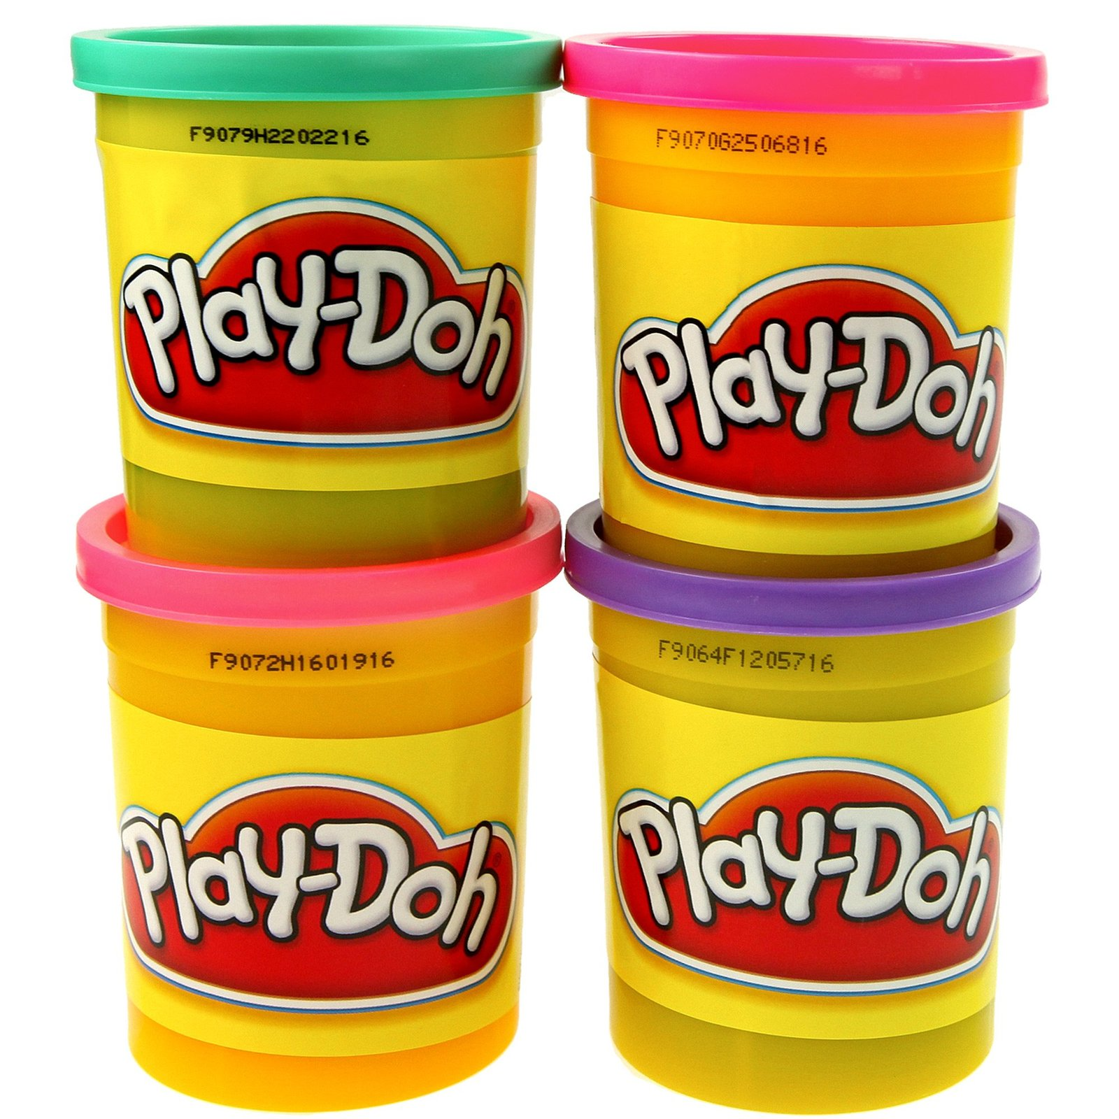
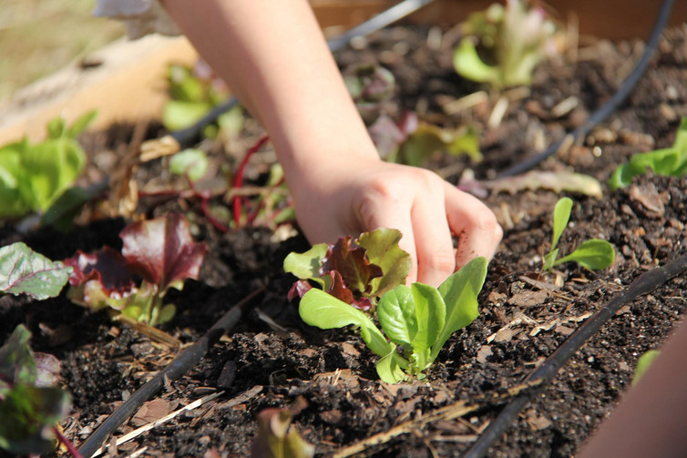
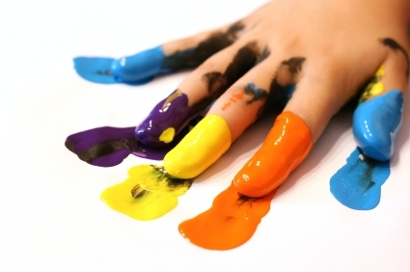
Fine Motor Skills
Small movements in wrists, hands and fingers which supports writing development, cutting skills and even assists in learning to toe shoe laces.
Ideas;
playdough activities,
cutting out,
colouring in,
pencil control paths*,
building bricks,
padlock keys,
finger painting,
squeezing sponges,
water play,
gardening.

Slide 10
Hear-Say-Play-Write
HEAR – Listen to a story to provide a context for learning (e.g. The Tiger Who Came to Tea).
SAY – Discussion of the story, questioning of events/characters, likes/dislikes.
PLAY – Play with the story through puppets, masks, songs/rhymes, dances.
WRITE – Whole class shared writing experience (e.g. jumbled up sentence on board/missing words). Children will be provided opportunity for guided/independent writing based on the story (e.g. Create own tea party invitation, create own character to invite to tea).

Slide 11
Writing Progression
Ensure pencil is held correctly and letters are formed correctly!
Mark-making using different materials
Name practise – in lowercase letters
Begins with drawing increasingly more detailed pictures
Over-writing -> Under-writing
Labelling --> word bank
Copying from a model
Sentence building/missing words
Independent writing

Slide 12
Useful Resources
Washing line rhyme game - https://www.topmarks.co.uk/Search.aspx?q=online%20rhyming%20games
Letter formation - http://www.doorwayonline.org.uk/literacy/letterformation/
This website also has great sounds, blends and speller games under the Literacy tab!
Phoneme Pronunciation - http://www.gdss.glasgow.sch.uk/PlainText/PlainText.aspx?SectionId=707f6794-63e4-4cd8-b207-5c789ae48c4c&fbclid=IwAR0YHglaOXgL4Qy5TAziRbV6jxu92yUqU5xaP_w3iEoH67z4zLA2jkzJ0s4
YouTube –
Geraldine the Giraffe
Alphablocks
Jack Hartmann (rhyme and syllable songs)
Tricky Words Song

Slide 13
Thank you!
Any questions?
This Photo by Unknown Author is licensed under CC BY-NC

