Slide 1
P7 iPad Deployment
St Michael’s Primary School

Slide 2
P7 iPad Deployment
By November all children in primary 7 will be part of the iPad deployment scheme for Glasgow City Council.
All P7 children have now returned their home-school agreement to allow them to use their iPads at home.
Normally you would have been invited into school for a presentation, asked to sign a form and learn about what is happening. Due to Covid-19 restrictions this will all be done remotely.

Slide 3
What will your child have to do?
Connect to home WiFi
Keep the following details safe:
- 6 number passcode
-Apple ID login safe
-Glow and Showbie account details
-AD (Green) username and password

Slide 4
What should your child not be able to do?
Download unapproved Apps
Search unapproved websites
Share their iPad with others (Using iPad to help younger siblings with school work is ok)
Swap their iPad with others
Delete their search history

Slide 5
What your child has agreed to
Look after my iPad carefully at all times
Charge up my iPad every night and bring both the iPad and the supplied charger into school every day unless told otherwise
Always store my iPad in its supplied case when not in use, and store it in an appropriate school bag when outside my class
Only take my iPad out in class or in my home - never in the playground, when walking between classes or when travelling to and from school
Only use my iPad in lessons when instructed to by my teacher and close it or put it away when my teacher says so
Only use programs on my iPad that my teacher has agreed I can use in the lesson

Slide 6
What your child has agreed to
Only use my iPad to record audio or video clips with the clear and explicit permission of everyone involved in the recording
Never access inappropriate content on my iPad
Never remove any asset tags or security markings from my iPad
Do not allow the iPad to be subject to graffiti
Immediately report any damage, loss or theft to the school
Report any technical problems to Mr Gallagher or my teacher
Ensure that all work stored on the iPad is regularly backed up

Slide 7
What your child has agreed to
Ensure that my child cares for and respects their iPad
Immediately report any loss or theft which happens out of school, firstly to the police and then to Mr Gallagher.
Ensure that the iPad is used solely by the child that the school has given it to
Ensure that the iPad is returned to the school if your child leaves the school, or at any other time upon the request of a member of staff
Monitor my child’s use of the iPad on the Internet at home, to ensure that only appropriate websites are accessed - the same filtering will apply as in school

Slide 8
What is the school agreeing to?
Provide pupils with an iPad and access to a range of e-Learning resources
Give pupils an introduction to using and caring for the iPad. This will include a session on security, e-Safety, maintenance and health and safety
Provide pupils with a range of learning opportunities which make use of the iPad, both in school and at home
Provide parents/carers with ongoing advice to help them support their child’s use of their iPad
Make sure that any repairs required on the iPads are communicated to our IT service provider to ensure they are dealt with as quickly and effectively as possible
Provide access to wireless internet provision within the school. Provision will be made during school opening hours to allow pupils to complete homework/carry out research using the internet if required. The school will not be responsible for any costs involved, nor content accessed, when the Internet is used out of school
Issue questionnaires to pupils and parents/carers to help us in the ongoing evaluation of the project

Slide 9
Lost or Stolen iPads
If the student does not bring an iPad to school for a number of days the teacher will assume the iPad has been lost or stolen. If you think your iPad has been lost or stolen you must report it immediately to the school. Once the school knows this the iPad will be wiped remotely. The iPad will then no longer be able to be turned on. If you subsequently find the iPad please return to the school as soon as possible.

Slide 10
Rule Breaking
If a pupil breaks the iPad rules that they have agreed to then the school reserves the right to restrict or remove their access to any school ICT facility as in line with the Pupil Acceptable Use Policy.

Slide 11
Digital Leaders
P7 Digital Leaders of Learning will be helping with digital technology throughout the year. This includes helping younger children with online resources and maintaining iPads for the whole school! All P7s have opportunities for digital leadership.
Digital Lead Teachers:
Mr Gallagher
Miss Healy
Class Teachers
P7 Miss Cullen
P6/7 Mrs Devlin

Slide 12
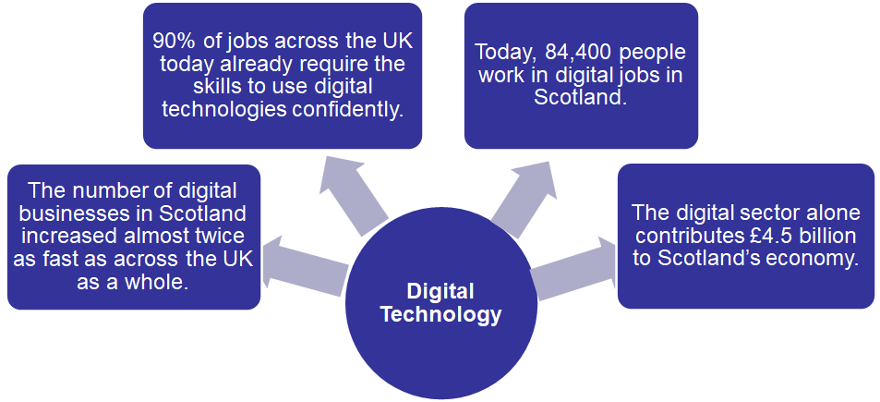
Why has Glasgow invested in digital technology in schools?

Slide 13
Why are we developing digital
technology in schools?
Click on the link below to watch a video on Digital literacy and why it matters…
https://www.youtube.com/watch?v=p2k3C-iB88w&feature=emb_title

Slide 14
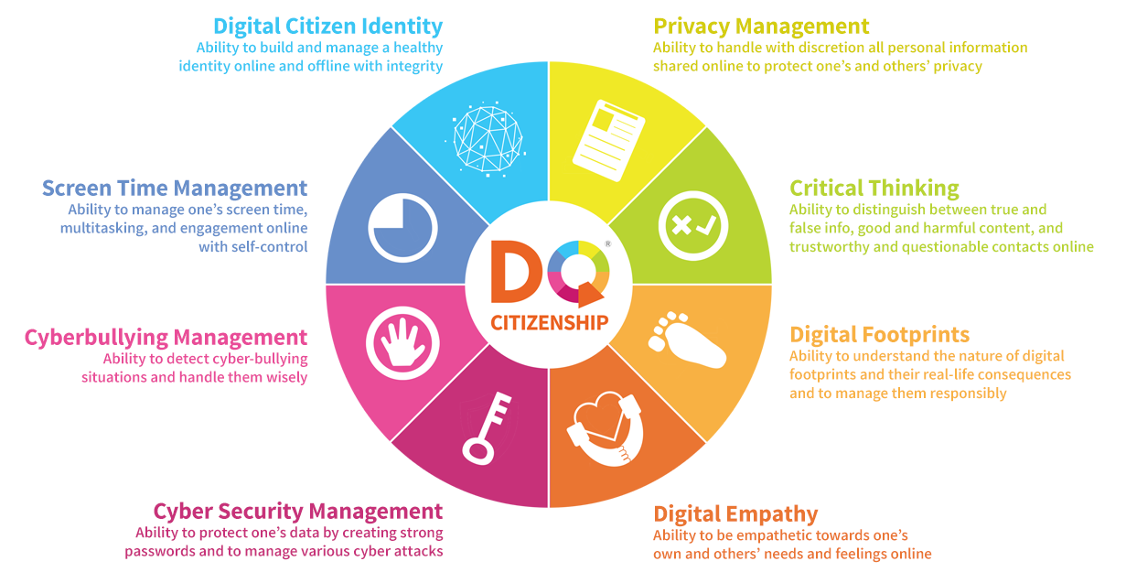
World Economic Forum: Essential Digital Skills

Slide 15
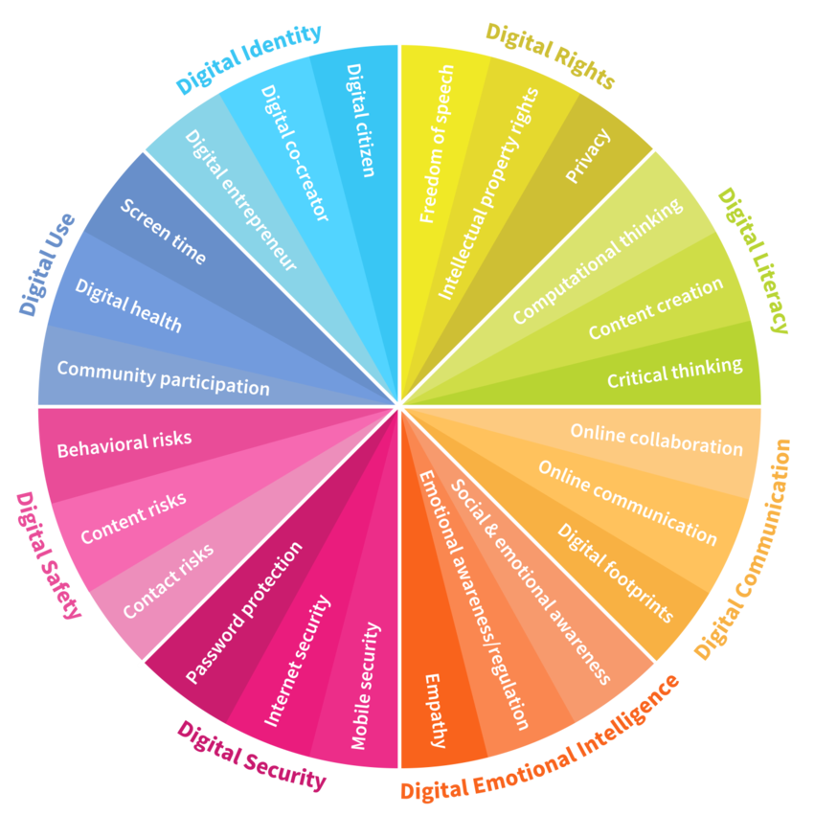
Essential Skills for Young People to Learn

Slide 16
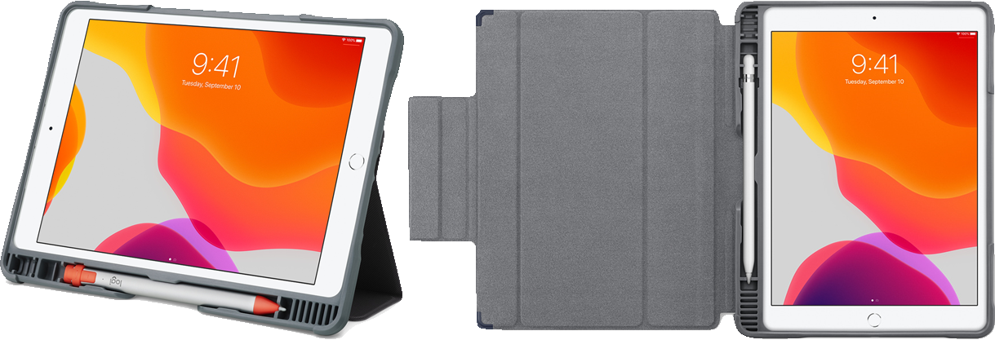
What will your child receive?
iPad, Cover and Charger

Slide 17
Further information on internet safety for parents and carers
https://www.childnet.com/parents-and-carers
https://www.internetmatters.org/resources/tech-guide/
https://www.saferinternet.org.uk/advice-centre/parents-and-carers#:~:text=As%20a%20parent%20or%20carer,internet%20safely%2C%20responsibility%20and%20positively.
https://www.nspcc.org.uk/keeping-children-safe/online-safety/
https://www.thinkuknow.co.uk/parents/

Slide 18
Charging iPad
Charging an ipad costs 0.5p each time it goes from 0 -100%

