Slide 1
Anti bullying week
17 – 21st November

Slide 2
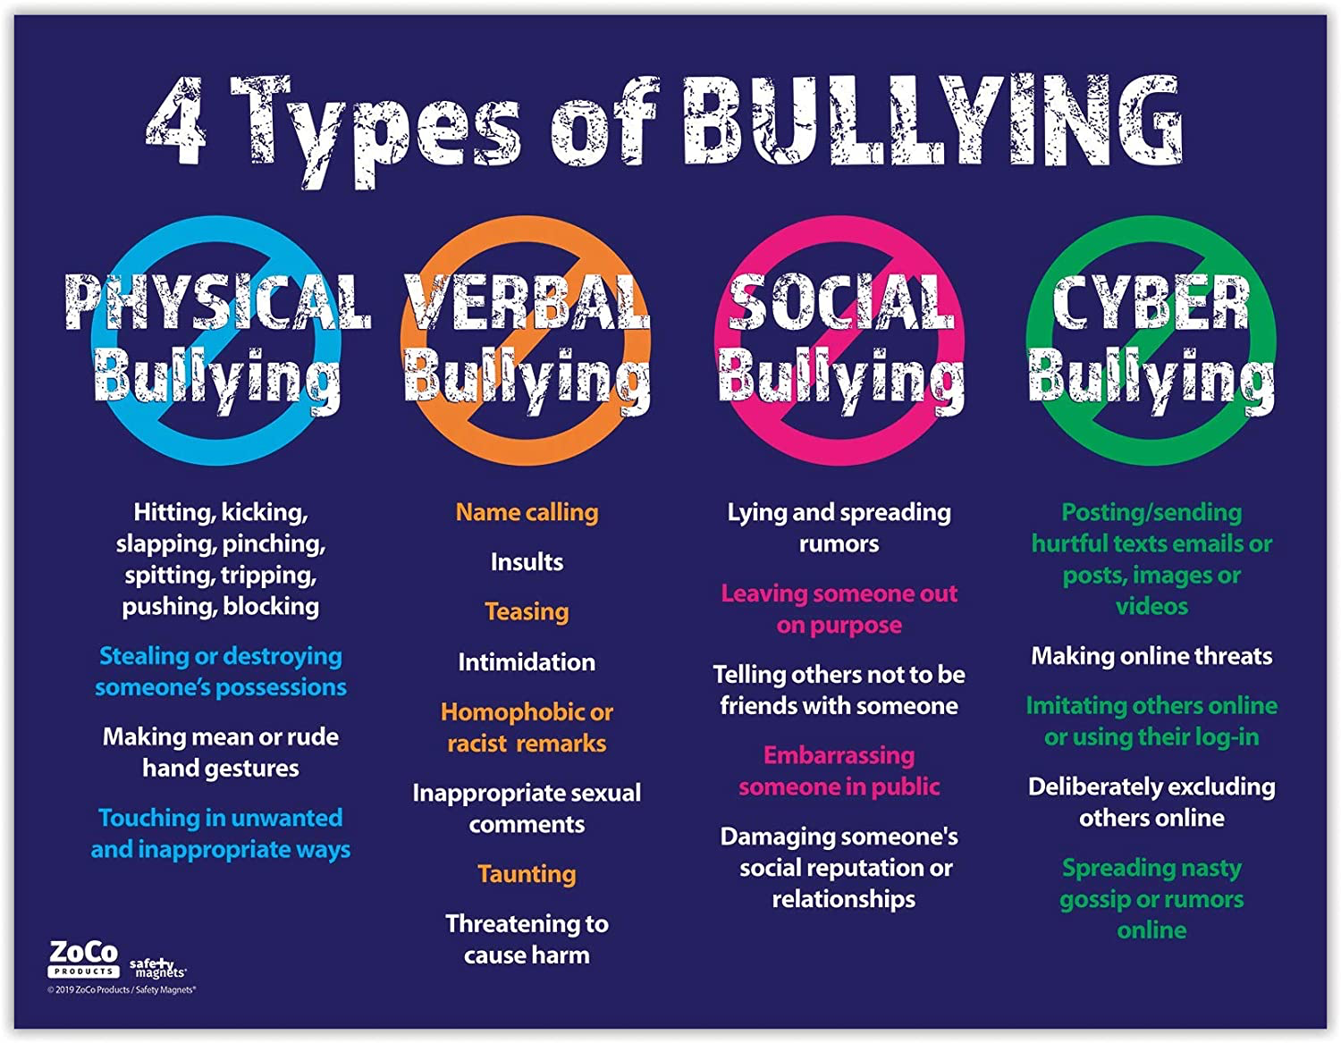
Types of bullying
Physical
Verbal
Social
Cyber

Slide 3
Different ways to bully
Cyber
Lies
Gossiping
Rumours
Name calling
Pushing
Teasing
Threats

Slide 4
How bullying makes people feel
Upset
Angry
Hurt
Worthless
Annoyed

Slide 5
United against bullying
https://www.youtube.com/watch?v=e8e7NRIk4AA

